Slide 1
Git Integration Branches & Merge requests
- demo via Visual Studio Code

Slide 2
Prerequisites
1) Visual Studio Code (VS Code)
This is the Salesforce recommended IDE
It is the go-to code editor for Salesforce developers
For future details: https://trailhead.salesforce.com/en/content/learn/projects/quick-start-lightning-web-components/set-up-visual-studio-code
To Install: Select corresponding version from: https://code.visualstudio.com/download
Install VS Code (see next slides)
For a guide on getting started with VS Code, go to: https://code.visualstudio.com/docs?start=true
2) Install Git Lens extension of VS Code for deeper interactions with Git projects: https://gitlens.amod.io/

Slide 3
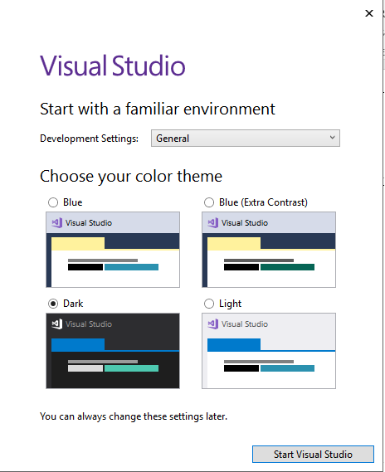
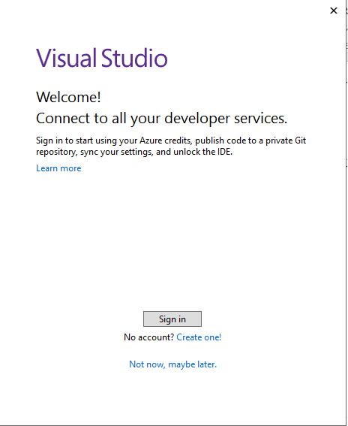

Slide 4
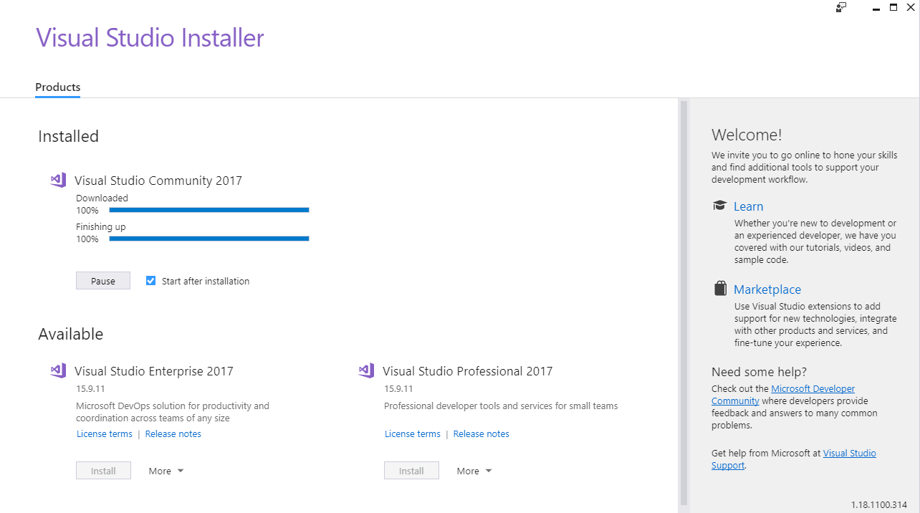

Slide 5
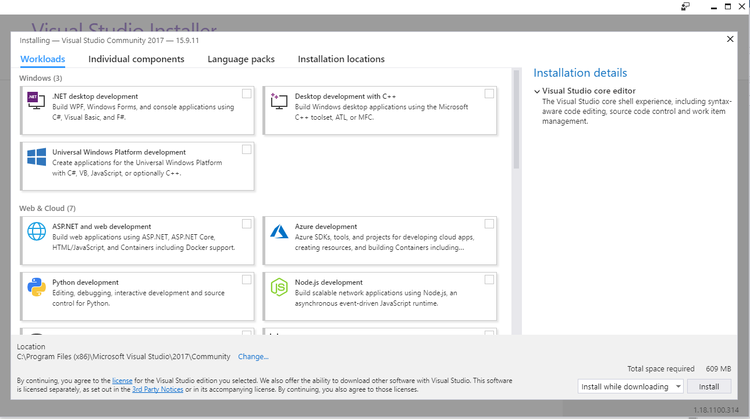

Slide 6
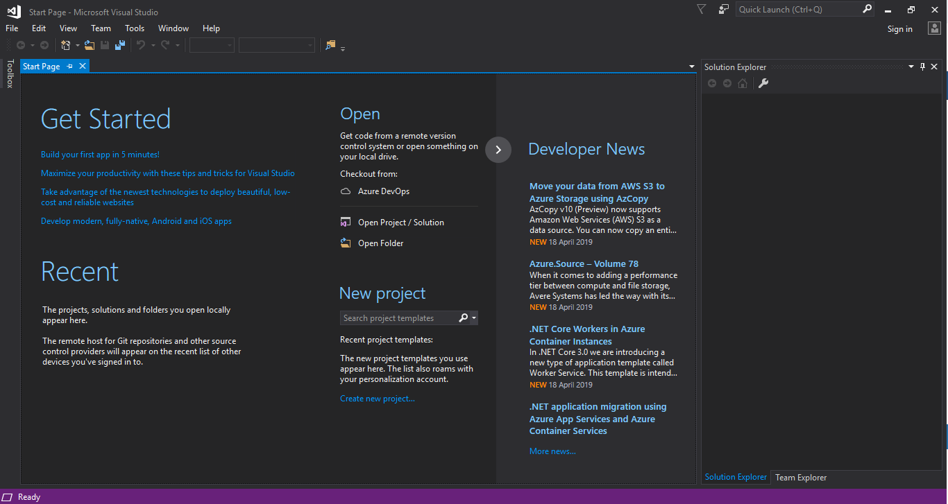

Slide 7
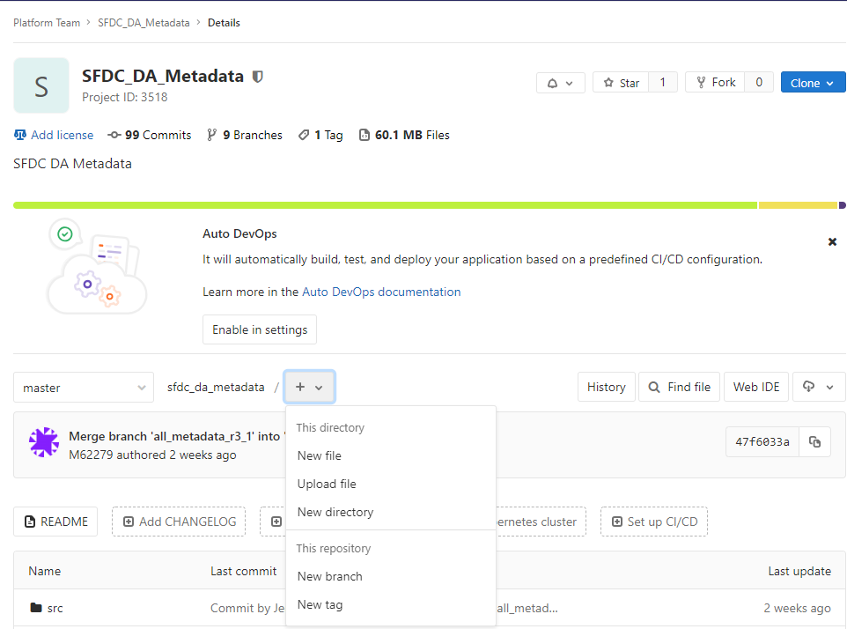
Step 1 – Create a branch
In the context of Salesforce CI/CD Pilot, this can be done only by people with GitLab Maintainer role following a Jira request.
The below steps are only to be done by a Senior Developer with enhanced roles (GitLab Maintainer) or Platform DevOps member
It can be achieved in 3 ways:
From UI (see attached screenshot)
-- click + button and “New branch”
Via Commands:
In VS Code: Ctrl + Shift + P
-- git branch branch_name
(this will create a branch off of current branch)
Via Pipeline:
Run a job which creates Branches on request
… [details]

Slide 8
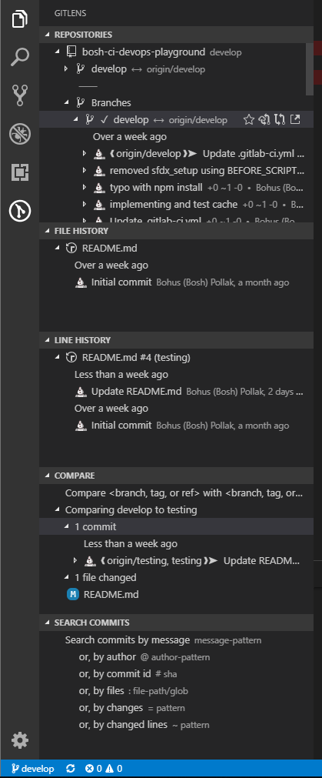


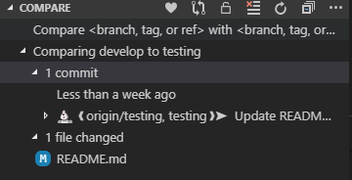
Step 2 – Compare branches
After Installation of Git Lens extension for VS Code
Branches can be compared via: :
A)Open the Explorer view (Ctrl + Shift + E) and find Git Lens group
B)right click source branch and select 'Select for Compare',
C)right click the destination branch and select 'Compare with Selected‘
D) results will show up as a separate group called ‘Compare’ showing the commits.
For example, comparing branch develop to testing produces a result like (e.g.):

Slide 9
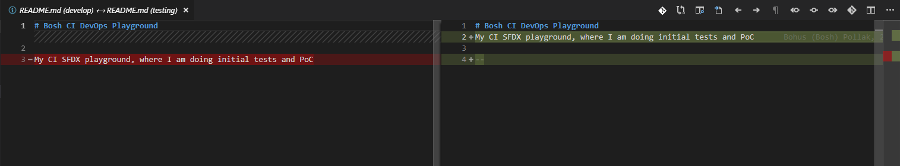
Step 2.1 – Compare files
Comparing files is triggered via:
Double-clicking on changed file (e.g. README.md)
This will produce a comparison window on the right
(see below) source branch on left, destination on right

